Slide 1
Database Management CSE303
Student Performance monitoring system Group-4

Slide 2
Group Members
Misbahur Rashid – 1721911
Rafid Al Ahsan – 1722006
Md.Musfiqur Rahaman – 1721684
Sadia Afroz Alma - 1730407
Md.Sakimuzzaman – 1721527
Puja Bhowmik – 1730791
Elan Md Taseen - 1831050

Slide 3
Background of the organization:
Independent University, Bangladesh (IUB) is one of the leading and oldest private university in Bangladesh where academic excellence is a tradition, teaching a passion and lifelong learning a habit. It was established in 1993. It has an explicit focus on Research and Global partnerships. The IUB campus sprawling over 3 acres, has an amphitheater, the state-of-the-art laboratories, well-equipped library with online access to journals and books, above 70 classrooms, lecture galleries, auditorium, gymnasium, food court, playground, medical Center, counseling Center and an alumni office.
IUB has world-class undergraduate and graduate program accredited by professional national 7 international accreditation bodies, such as University Grants Commission of Bangladesh (UGC), Accreditation Council for Business Schools and Programs (ACBSP), USA, and Institution of Engineers, Bangladesh (IEB). IUB prepares graduates for a successful career and this is central to the design of courses and the support we provide. The programs and the courses are designed in such a way that prepare the students for a successful career. The faculty members of IUB are actively engaged in research and publish regularly in peer-reviewed journals. Along with conventional classroom based teaching, students are engaged in research relatively early in their studies. IUB has academic research collaborations with various universities including Harvard University, Stanford University, University of Colorado at Boulder, Brown University, McMaster University, University of Heidelberg. IUB also participate in various national level inter-university sports, robotics, debates and similar competitions.

Slide 4
Background of the project:
The Student Performance Monitoring System focuses on performance monitoring of student’s continuous assessment (tests) and examination scores in order to predict their final achievement status upon graduation.
The main theme of this project is to find the systemic problems and limitation we have in our current system in few areas and how can we improve it. The aim of our project is to design, build and deliver a developed software that we believe will help universities everywhere to promote a more productive and effective way of evaluating students. Also there need to be some functional changes in the system and department. We also analyze individual processes that take place under the current system of monitoring student performance and the concerns and problems with those process from start to finish.

Slide 5
Objective of the project:
We want to develop the existing software iras in such way that can be more user friendly and helpful .it will help the institution to improve the quality of education. where the students and the faculty can use the system and find information more easily .in a short passage of time they can find all the information related to student enrollment, student grades, students CGPA and also CO and PLO.
It will also benefit all the departments of the institution. this development will boost the work rate of everyone. it will be more productive and effective. not only the iras but also in different aspect few things need to be changed where we worked on. Monitoring semester wise student performance report by an Instructor and also analyze how to Department head submit grades of the students instead of faculty.

Slide 6
Scope of the project:
Project scope is a prerequisite to guarantee the success of a project. We have to make sure that the new system can be more successful than the present one when we are modifying an existing system.
We build an interface for faculties to able to see grades of another courses of a Student. Department can also access the systems for uploading grades instead of Instructor. If for some reason the instructor cannot upload the grade, then the Department can do it. On the other hand, Department head will be able to view different activities according to the different courses and sections of the instructor like Instructor’s Attendance,
Course wise Student performance etc.
Data will also, be protected and each user will be shown only that data which is relevant to them.

Slide 7
Introduction
The Student Performance Monitoring System (SPMS) focuses on performance monitoring of student’s continuous assessment and examination scores in order to predict their final achievement status upon graduation.
The main goal of this project is to find the systemic problems and limitation we have in our current system in few areas and how can we improve it. The aim of our project is to design, build and deliver a developed software that we believe will help universities everywhere to promote a more productive and effective way of evaluating students. The faculties can input the COs for each of their students so that the system can map the COs to PLO accordingly. We also analyze individual processes that take place under the current system of monitoring student performance and the concerns and problems with those process from start to finish.

Slide 8
Project analysis slide 2
Database Management
Rich Picture
ERD & Relational Schema
SPMS
Six Element Analysis
Normalization
Process Diagram
Data Dictionary

Slide 9
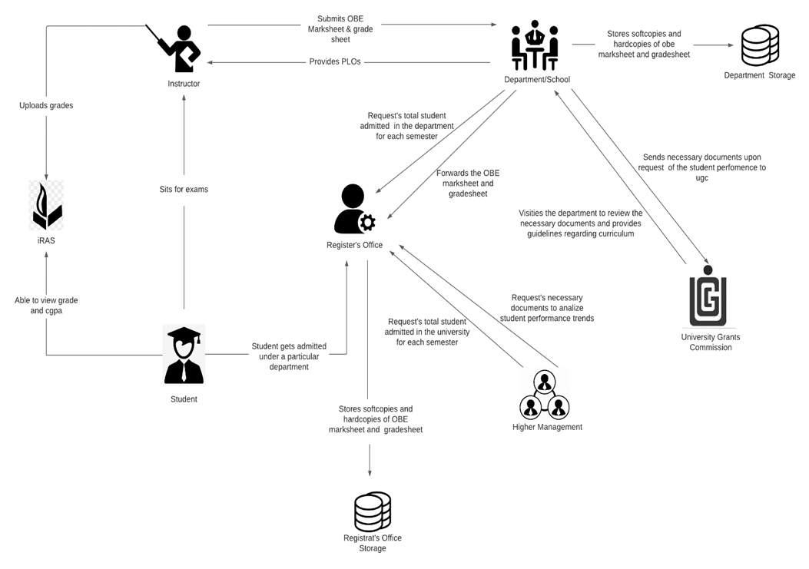
RICH PICTURE(AS-IS)

Slide 10
SIX ELEMENT(AS-IS)
Student sits for exam
Student are able to view grades, CGPA and download transcript
Instructors uploads grades to IRAS
Instructors produce OBE mark sheet and grades sheet and submits it to the department
Map Course Outcomes (COs) to Program Learning Outcomes(PLOs)
Student gets admitted under a particular department
Request for review and change of grades
View Records OBE Mark sheets and Course Assessment Reports

Slide 11
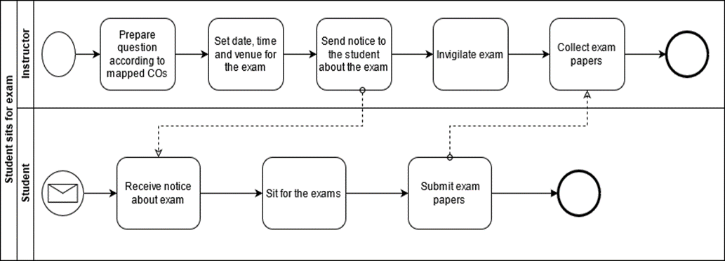
PROCESS DIAGRAM(AS-IS)
FIGURE 2.1 Process Diagram for Student Sits for exam

Slide 12
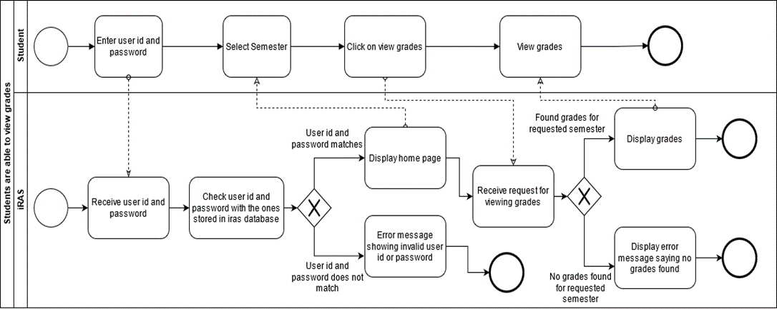
FIGURE 2.2 Process Diagram for Student are able to view grades and CGPA

Slide 13
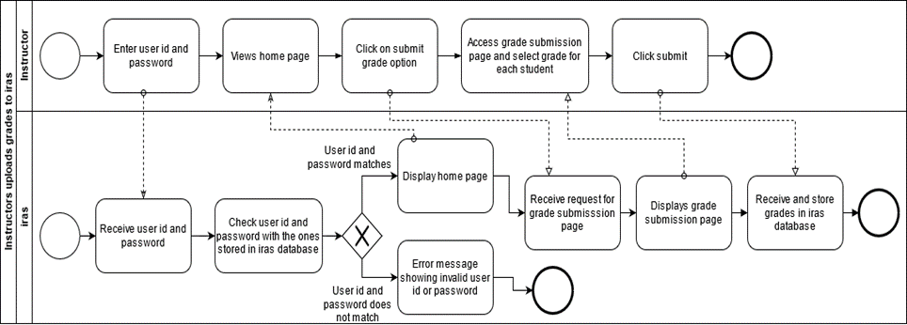
FIGURE 2.3 Process Diagram for Instructor uploading grade to iras

Slide 14
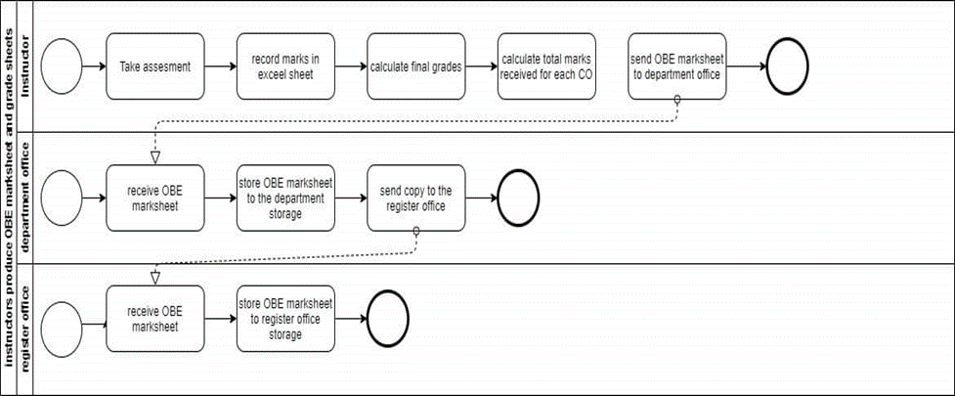
FIGURE 2.4 Process Diagram for Instructor produces OBE mark sheet

Slide 15
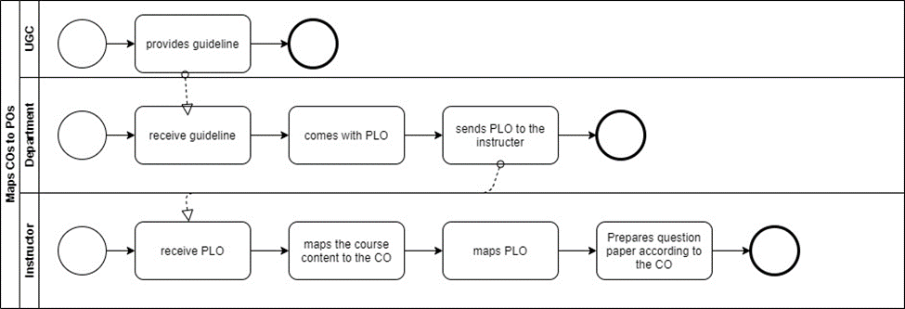
FIGURE 2.5 Process Diagram for Map COs and POs

Slide 16
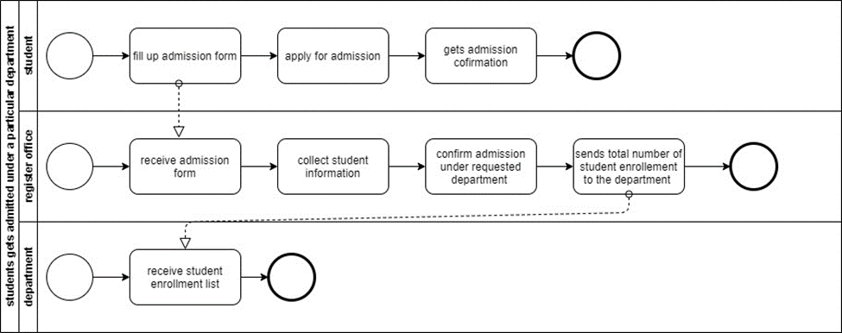
FIGURE 2.6 Process Diagram for Student gets admitted under particular department

Slide 17
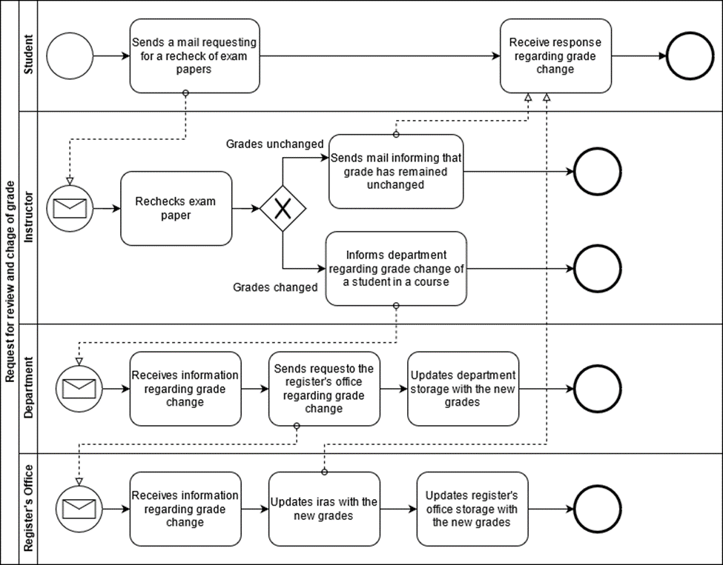
FIGURE 2.7 Process Diagram for request for review and change of grades

Slide 18
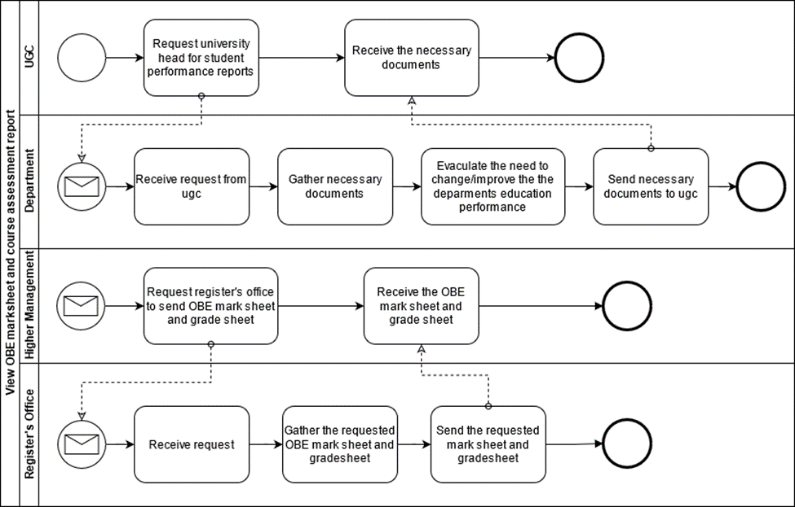
FIGURE 2.8 Process Diagram for view obe mark sheet and course assessment report

Slide 19
Problem Analysis
Preparing a Course Assessment
Higher Management Viewing Individual Instructor Performance
Instructor viewing the CGPA and change the grade
Higher management and Instructor viewing OBE mark sheet and grade sheet
Students will be able to get grades from Department instead of Instructor
Higher Management & Instructor Uploading & Viewing PLOs/CO
Student viewing PLO & CO
UGC approves curriculum based on PLO and CO

Slide 20
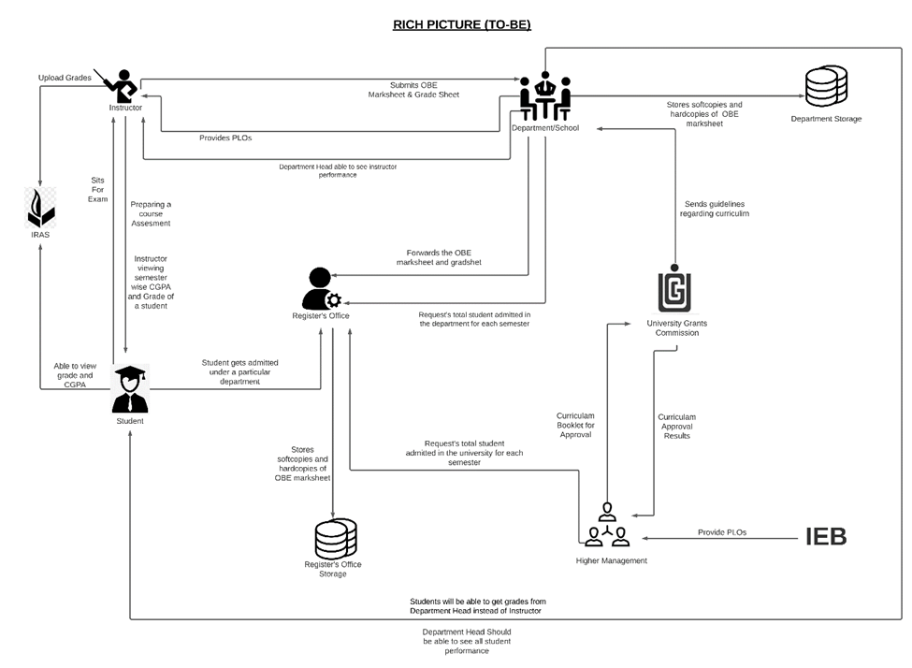
RICH PICTURE (TO-BE)

Slide 21
SIX ELEMENT (TO-BE)
Preparing Course Assessment of Instructor
Instructor Able to see the result of another courses of a Student
Students will be able to get grades from Department instead
UGC approves curriculum based on PLO and CO
Department Head able to see all instructor Performance
Higher Management and Instructor viewing OBE mark sheets and grade sheet
Instructor viewing CGPA and change the grade
Student viewing PLO & CO

Slide 22
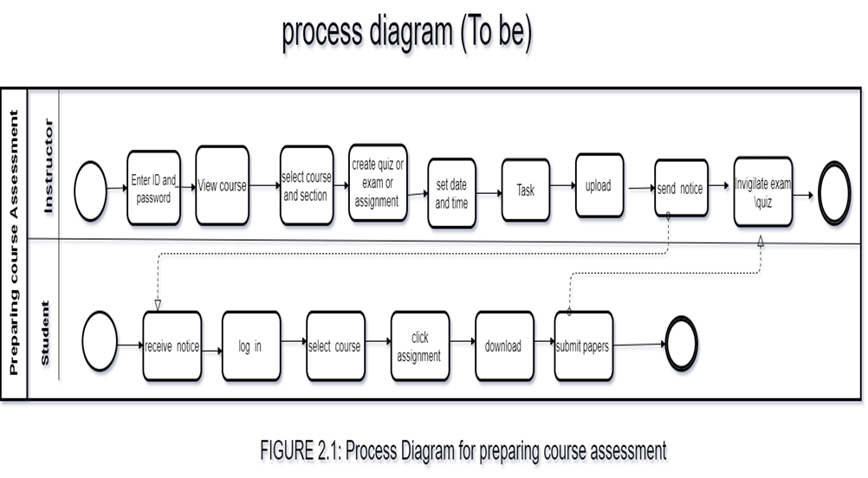
PROCESS DIAGRAM (TO-BE)

Slide 23
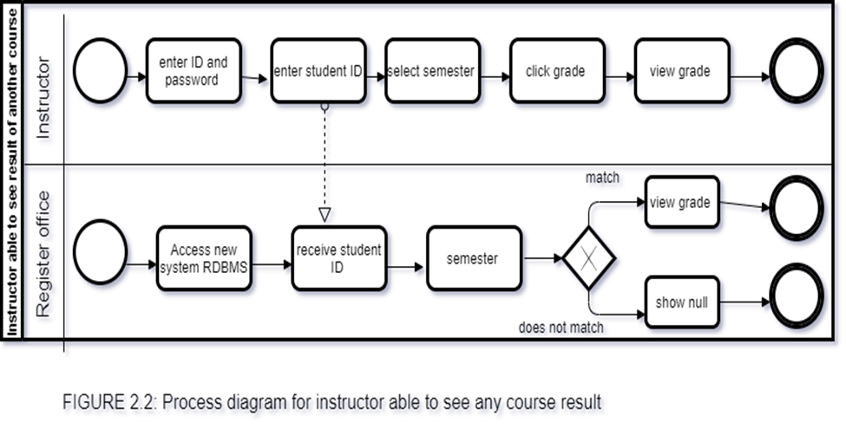

Slide 24
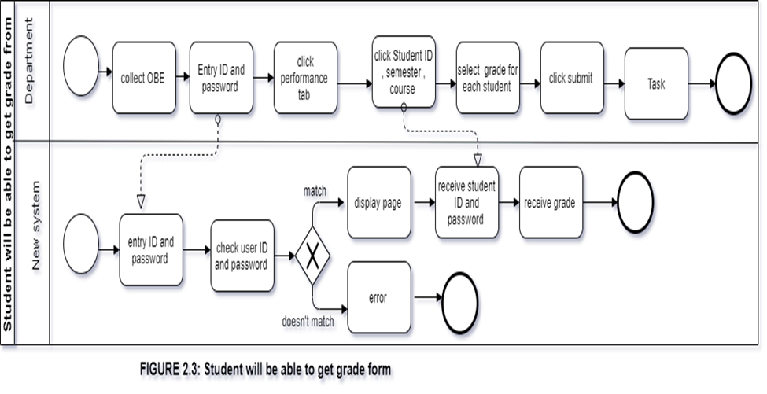

Slide 25
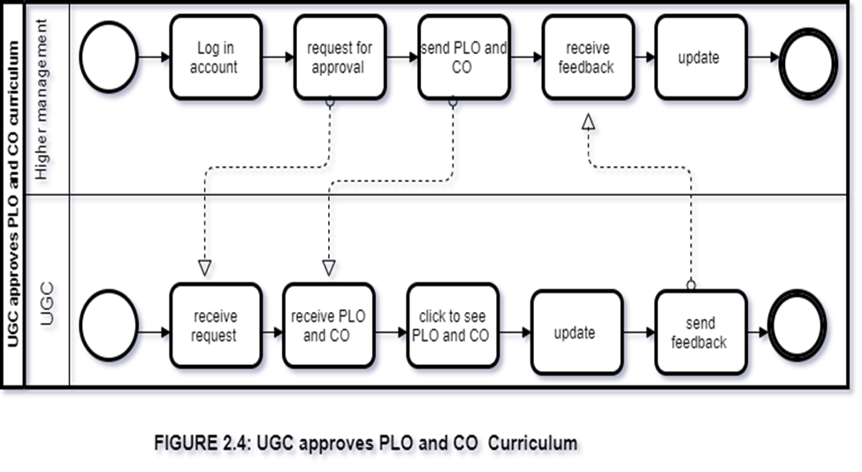

Slide 26
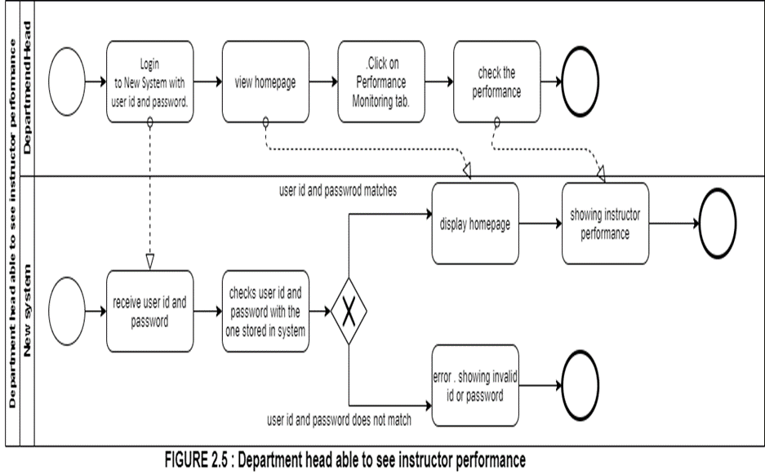

Slide 27
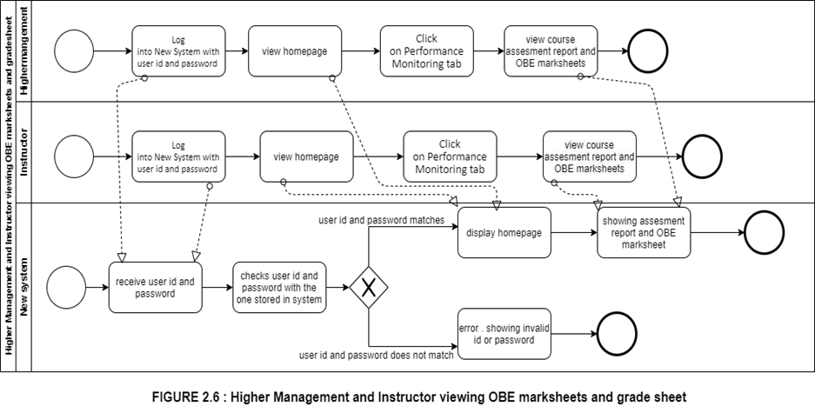

Slide 28
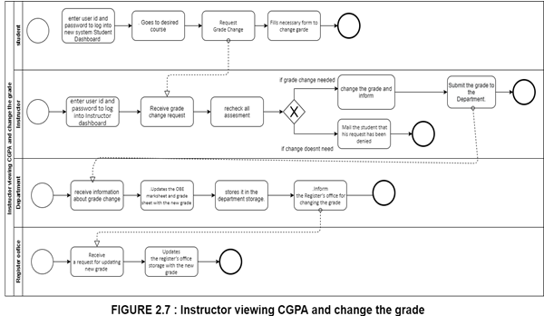

Slide 29
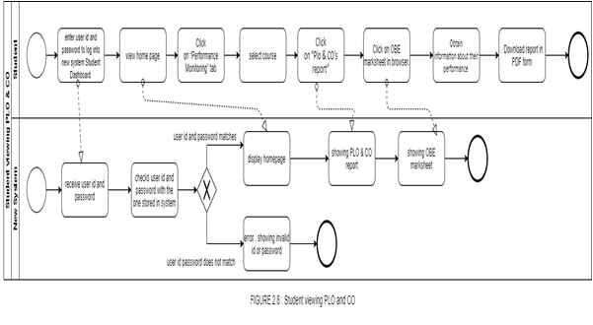
FIGURE 2.8 Student viewing PLO &CO

Slide 30
BUSINESS RULE
1) A student may register under one or more programs. A program many have multiple students.
2) A department may have multiple programs. A program must be exactly under one department.
3) A school may have multiple departments. A department must be exactly under one school.
4) A department may have multiple instructors. An instructor must be exactly under one department.
5) A department must have exactly one head.
6) A school must have exactly one dean.
7) A program may have multiple PLOs. A PLO many be under multiple programs.
8) An instructor may teach multiple courses. A course must have exactly one instructor.
9) A course may have multiple sections. A section must be under exactly one course.
10) A student may tale multiple assessments. A particular assessment must be taken exactly by one student.
11) A section may have multiple assessments. An assessment must have one exact section.

Slide 31
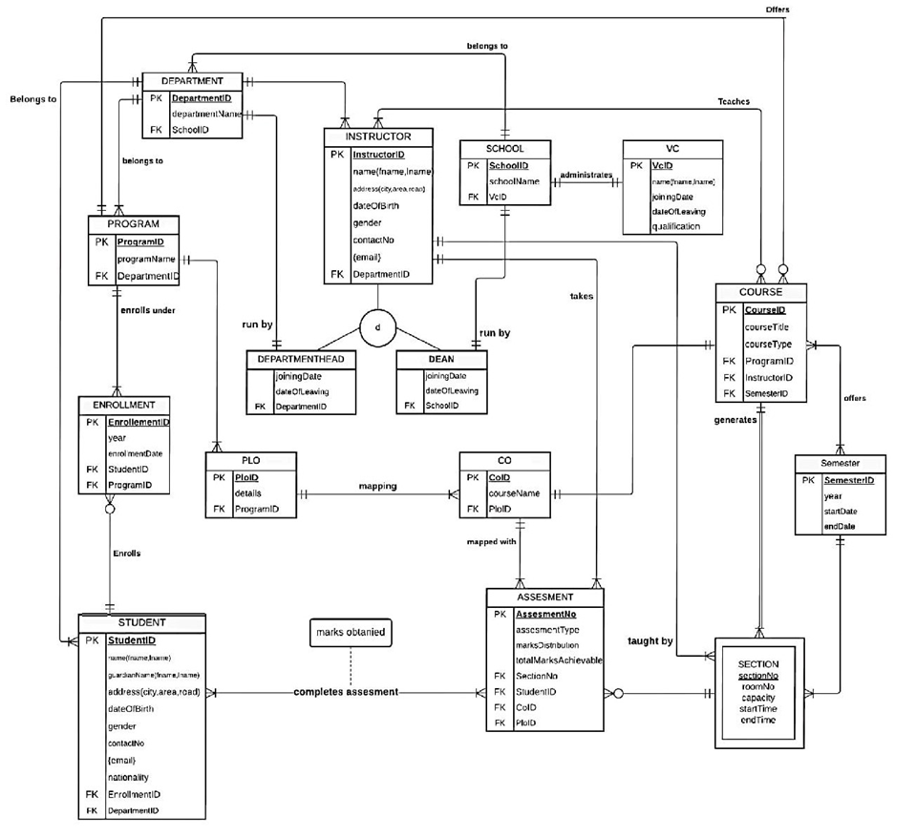
ENTITY RELATIONSHIP DIAGRAM

Slide 32
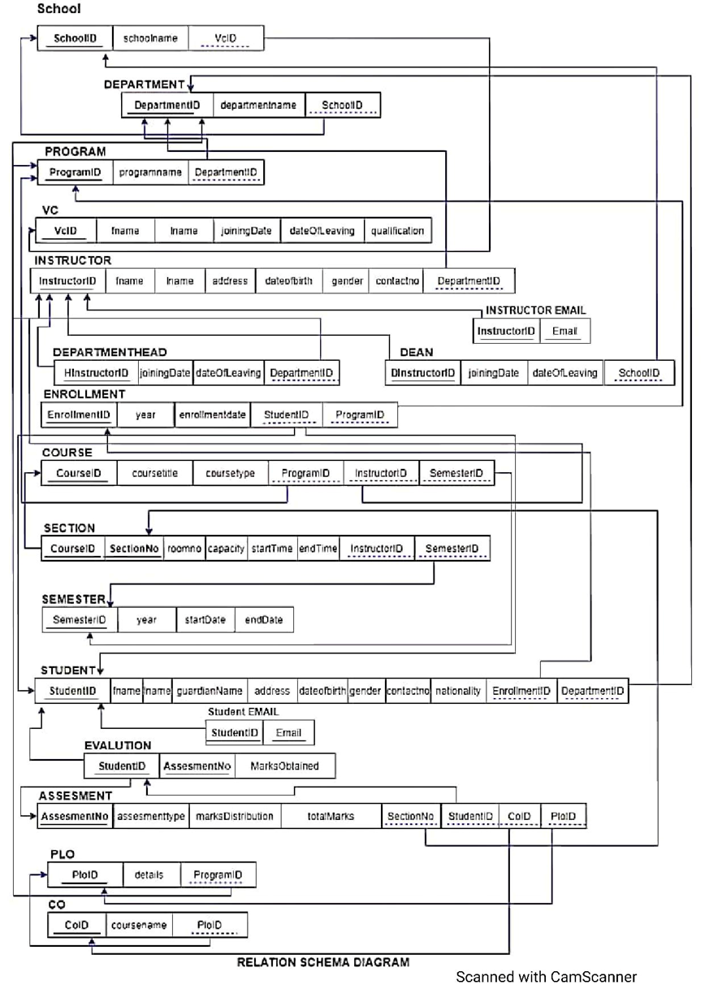
ENTITY RELATIONSHIP DIAGRAM TO RELATIONAL SCHEMA

Slide 33
NORMALIZATION
School | SchoolID | s1 | Enrollment | enrollemntID | n1
 |  |  |  | year | n2
 | School name | s2 |  | Enrollment date | n3
 | VCID | v1 |  | studentID | t1
 |  |  |  | ProgramID | p1
VC | vcID | v1 | student | studentID | t1
 | Fname | v2 |  | fname | t2
 | Iname | v3 |  | iname | t3
 | Joining datew | v4 |  | City | t4
 | Leaving date | v5 |  | Road | t5
 | Qualification | v6 |  | Area | t6
Department | departmentID | d1 |  | Date of birth | t7
 | Departmentname | d2 |  | Gender | t8
 |  |  |  | Contact no | t9
 | schoolID | S1 |  | Nationality | t10
program | programID | p1 |  | enrollmentID | n1
 | Program name | p2 |  | departmentID | d1
 | departmentID | d1 | Assessment | Assessment ID | a1
Instructor | InstructorID | i1 |  | Assessment type | a2
 | fname | i2 |  | Marks distribution | a3
 | Iname | i3 |  | sectionNO | e1
 | City | i4 |  | studentID | t1
 | Area | i5 |  | COID | o1
 | Road | i6 |  | PLOID | l1
 | Date of birth | i7 |  | Student complete assessment | a4
 | Gender | i8 |  | Student marks obtained | a5
 | Contact no (gmail) | i9 | Course | courseID | c1
 | DepartmentID | d1 |  | Course title | c2
Department Head | departrmentheadID | h1 |  | Course type | c3
 | qualification | h2 |  | programID | p1
 | Joining date | h3 |  | InstructorID | i1
 | Date of leaving | h4 |  | semesterID | r1
Dean | deanID | x1 | Section | sectionNO | e1
 | Annual salary | x2 |  | courseID | c1
 | Joining date | x3 |  | Room no | e2
 | Date of leaving | x4 |  | capacity | e3
 |  |  |  | Start time | e4
 |  |  |  | End time | e5

Slide 34
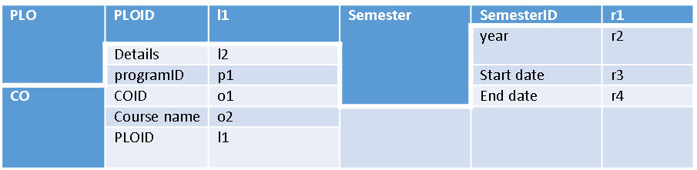

Slide 36
1NF
Arrange all the relationship. There are multiple attribute and there are no repeating groups.
2NF
Remove all the partial dependence. There are no composite keys present this step is not required.

Slide 37
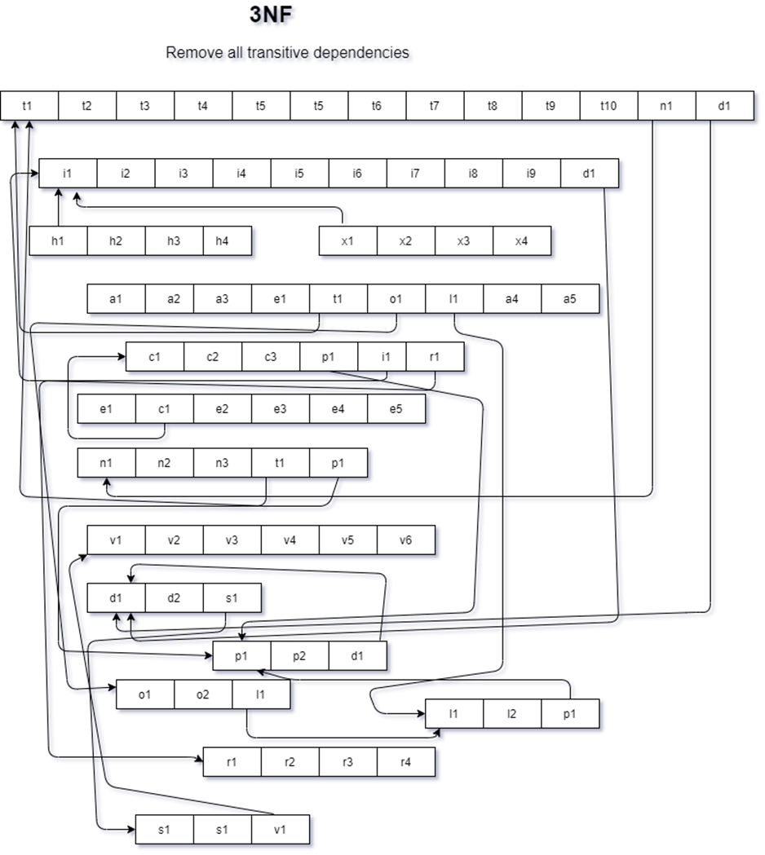
3NF

Slide 38
BCNF
No non-key attribute can identify can primary key or part key. So all relationship is in BCNF

Slide 39
DATA DICTIONARY
VC_T
Name | DataType | Size | Remark
nvcid | Number | 7 | This is the Primary Key for VC. Example: “19*****”
cname | Text |  | This is the name of vc Example: “md khan”
djoiningDate | DateTime |  | This contains the date when vc took charge of his role Example : “01.01.2016”
dleavingDate | DateTime |  | This contains the date when vc discharged from his role Example : “01.01.2020”
cqualification | Text |  | This contains the qualification of vc Example “ PHD , BSC”

Slide 40
Data Dictionary
Vc_T
Name | DataType | Size | Remark
nvcid | Number | 7 | This is the Primary Key for VC. Example: “19*****”
cname | Text |  | This is the name of vc Example: “md khan”
djoiningDate | DateTime |  | This contains the date when vc took charge of his role
dleavingDate | DateTime |  | This contains the date when vc discharged from his role
cqualification | Text |  | This contains the qualification of vc Example “ PHD , BSC”

Slide 41
Department_T
Name | DataType | Size | Remark
cschoolid | Text | 5 | This is the Primary Key of School Example: “SETS”
Cschoolname | Text |  | This is the name of the School. Example: “School of Engineering, Technology and Science”
nvcid | Number |  | This is the foreign key from the VC table . Example : “19*****. “
School_T
Name | DataType | Size | Remark
cdepartmentid | Text |  | This is the Primary Key of the Department. Example: “EEE”
cdepartmentname | Text |  | This is the name of the Department. Example: “Computer Science and Engineering”
cschoolid | Text |  | This is the Foreign Key of the table School. Example: “SETS”

Slide 42
Student_T
Name | DataType | Size | Remark
nstudentid | Number |  | This is the Primary Key for the Student. Example: “1800001”
cname | Text |  | This is the name of the Student. Example: “Muhammad Akib”
cguardianname | Text |  | This is the name of the guardian. Example: “Muhammad karim”
caddress | Text |  | This is the address of the Student. Example: “House 270, Road 6, Block C, Bashundhara, Dhaka, Bangladesh
ddateofbirth | Datetime | “dd/mm/yy” | This the Date of Birth of the Student. Example: “01-01-2000”
cgender | Text |  | This is the gender of the Student. Example: “M”
ncontactno | Number |  | This is the phone number of the Student. Example: “0191211141”
cemail | Text |  | This is the email address of the Faculty. Example: “mahady@iub.edu.bd”
cnationality | Text |  | This contains nationality of the student Example: “Bangladeshi”
ndepartmentid | Text |  | This is the Foreign Key from the Department table. Example: “CSE

Slide 43
Instructor_T
Name | DataType | Size | Remark
ninstructorID | Number |  | This is the Primary Key for Faculty. Example: “1501*** “
cname | Text |  | This is the first name of the instructor. Example : “ Abdur Rahim”
caddress | Text |  | This is the address of the instructor. Example: “House 1, Road 1, Sector 1, Uttara, Dhaka, Bangladesh
ddateofbirth | DateTime | DD-MM-Y YYY | This the Date of Birth of the instructor. Example: “01-01-1993”
cgender | Text |  | This is the gender of the instructor . Example: “F”
ncontactno | Number |  | This is the phone number of the instructor. Example: “01910101010”
cemail | Text |  | This is the email address of the instructor. Example: “rakib@iub.edu.bd”
cdepartmendid | Text |  | This is the Foreign Key from the Department table. Example: “CSE

Slide 44
Departmenthead_T
Name | DataType | Size | Remark
djoiningDate | DateTime |  | This contains the date when a vc took charge of his role Example : “01.01.2016”
dleavingDate | DateTime |  | This contains the date when a vc discharged from his role Example : “01.01.2020”
cdepartmentID | Text |  | This is the Foreign Key from the Department table. Example: “CSE
Dean_T
Name | DataType | Size | Remark
djoiningDate | DateTime |  | This contains the date when a vc took charge of his role Example : “01.01.2016”
dleavingDate | DateTime |  | This contains the date when a vc discharged from his role Example : “01.01.2020”

Slide 45
PLO_T
PLO_T
Name | DataType | Size | Remark
cploid | Text | 5 | This is the primary key for Program Learning Outcome. Example: “PLO1”
cdetails | Text |  | This is the details of the Program Learning Outcome. Example: “An ability to select and apply the knowledge, techniques, skills, and modern tools of the computer science and engineering discipline”
cporgramid | Text |  | This is the foreign key from Program table Example: ”B.Sc”.
cschoolid | Text |  | This is the Foreign Key of the table School. Example: “SETS”

Slide 46
CO_T
Name | DataType | Size | Remark
ccoid | Text | 5 | This is the Primary Key for Course Outcome. Example: “CO1”
ccoursename | Text |  | This is the name of the course Example: “Database management system”
cploid | Text |  | This is the foreign key from the Program Learning Outcome table. Example: “PLO1”

Slide 47
Enrollement_T
Name | DataType | Size | Remark
nenrollmentid | Number |  | This is the Primary Key for Enrollment Example : “12111111”
dyear | Datetime |  | This is the year of Enrollment Example: “2017”
denrollmntdate | DateTime | DD-MM-Y YYY | This contains the date of the enrollment. Example : 30/01/2021
nstudentid | Number |  | This is the Foreign key from the Student Table. Example: “1800001”
cprogramid | Text |  | This is the Foreign Key from Program table Example: ”B.Sc”.

Slide 48
Program_T
Name | DataType | Size | Remark
cprogramid | Text |  | This is the Primary Key for program. Example : “BSC”
cprogramname | Text |  | This is the name of the program . Example : “Bachelor of Science”
cdepartmentid | Text |  | This is the Foreign Key from the Department table. Example: “CSE”

Slide 49
Course_T
Name | DataType | Size | Remark
ccourseid | Text |  | This is the Primary Key for the Course. Example: “CSE203”
ccoursetitle | Text |  | This is the name of the Course. Example: ”Data Structure”
ccoursetype | Text |  | This is the type of the Course. Example: “Core”
cprogramid | Text |  | This is the Foreign Key from Program table Example: ”B.Sc”.
ninstructorid | Number |  | This is the Foreign Key from instructor table. Example :”1810000”
nsemesterID | Number |  | This is the Foreign Key from semester table.

Slide 50
Section_T
Name | DataType | Size | Remark
nsectionID | Number |  | This is the Primary Key for Section Example :”1001"
nsectionno | Number |  | This is the section number. Example: “4”
croomno | Text |  | This is the room number . Example : “B7107”
ncapacity | Number |  | This contains the total capacity of a room Example :”50”
dstarttime | Datetime |  | This contains the time when a class start .Example : “3 pm”
dendtime | Datetime |  | This contains the time when a class end. Example :”4.30 pm”

Slide 51
Assesment_T
Name | DataType | Size | Remark
nassesmentno | Number |  | This is the Primary Key for assessment . Example : “1”
cassesmenttype | Text |  | This is the type of assessment . Example : “Assignment ,Viva”
cmarksdistribution | Text |  | This contains the marks distribution
Ctotalmarksachievable | Text |  | This contains how much mark a student can achieve in total . Example : “100”
nsectionid | Number |  | This is the foreign key from section table Example” 1001”
nstudentid | Number |  | This is the foreign key from student table Example : “1810000”
ccoid | Text |  | This is the foreign key from the Program Learning Outcome table. Example: “CO1”

Slide 52
Semester_T
Name | DataType | Size | Remark
nSemesterid | Number |  | This is the Primary Key for semester
dyear | DateTime |  | This contains the year of that semester. Example:” 2021”
dstartdate | DateTime |  | This is the starting date of the semester. Example: “15.02.21”
denddate | DateTime |  | This is the ending date of the semester. Example: “10.05.21”

Slide 53
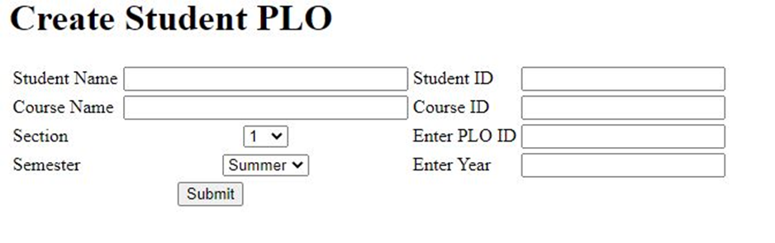
INPUT FORMS

Slide 54
html>
<body>
<form action="script.php" method="POST">
<table border="0">
<h1>Create Student PLO</h1>
<div class="plo">
<tr>
<td>Student Name</td>
<td align="center"><input type="text" name="studentName" size="30"/></td>
<td>Student ID</td>
<td align="center"><input type="text" name="studentId" size="20"/></td>
</tr>
<tr>
<td>Course Name</td>
<td align="center"><input type="text" name="courseName" size="30"/></td>
<td>Course ID</td>
<td align="center"><input type="text" name="courseId" size="20"/></td>
</tr>
<tr>
<td>Section</td>
<td align="center"><select type="select"

Slide 55
name="sectionNumber">
<option value="Section-1">1</option>
<option value="Section-2">2</option>
<option value="Section-3">3</option>
<option value="Section-4">4</option>
<option value="Section-5">5</option>
<option value="Section-6">6</option>
<option value="Section-7">7</option>
<option value="Section-8">8</option>
<option value="Section-9">9</option>
<option value="Section-10">10</option>
<option value="Section-11">11</option>
<option value="Section-12">12</option>
<td>Enter PLO ID</td>
<td align="center"><input type="text" name="coursePloId" size="20"/></td>
</td>

Slide 56
< <tr>
<td>Semester</td>
<td align="center"><select type="semester" name="semestername">
<option value="semester-1">Summer</option>
<option value="semester-2">Spring</option>
<option value="semester-3">Autumn</option>
<td>Enter Year</td>
<td align="center"><input type="text" name="year" size="20"/></td>
</td>
</tr>
</tr>
<tr>
<td colspan="2" align="center"><input type="submit" value="Submit"</td>
</tr>
</table>
</div>
</form>
</body>
</html>

Slide 57
OUTPUT
<?php
$con = mysqli_connect("localhost", "root", "", "charts");
if ($con) {
echo "connected";
}
?>
<html>
<head>
<script type="text/javascript" src="https://www.gstatic.com/charts/loader.js"></script>
<script type="text/javascript">
google.charts.load('current', {
'packages': ['corechart']
});
google.charts.setOnLoadCallback(drawChart);
function drawChart() {
var data = google.visualization.arrayToDataTable([
['students', 'contribution'],
<?php
$sql = "SELECT * FROM contribution";
$fire = mysqli_query($con, $sql);
while ($result = mysqli_fetch_assoc($fire)) {
echo "['" . $result['student'] . "'," . $result['contribution'] . "],";
}
?>

Slide 58
]);
var options = {
title: 'Department wise student Enrollment: '
};
var chart = new google.visualization.PieChart(document.getElementById('piechart'));
chart.draw(data, options);
}
</script>
</head>
<body>
<div id="piechart" style="width: 900px; height: 500px;"></div>
</body>
</html>

Slide 59
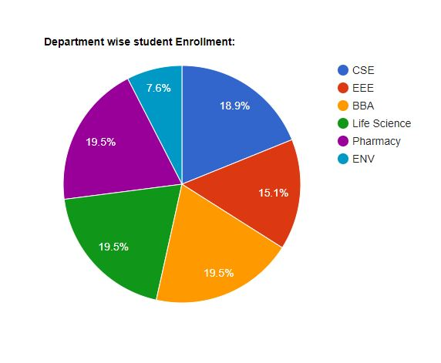

Slide 60
THANK YOU

